Slide 1


Практикум на ЭВМ.
Программирование под Android
Занятие 4

Slide 2
LayoutInflater

Slide 3
LayoutInflater
Создаёт иерархию объектов интерфейса из файла ресурса.
LayoutInflater inflater = (LayoutInflater)context.
getSystemService(Context.LAYOUT_INFLATER_SERVICE);
View view = inflater.inflate(R.layout.item_list, null, false);

Slide 4
Списки

Slide 5
ScrollView
Данные не помещаются на экран
Только 1 дочерний элемент

Slide 6
ScrollView
<ScrollView android:layout_width="match_parent" android:layout_height="match_parent"> <LinearLayout android:layout_width="match_parent" android:layout_height="wrap_content" android:orientation="vertical"> <TextView android:layout_width="wrap_content" android:layout_height="wrap_content" /> <TextView android:layout_width="wrap_content" android:layout_height="wrap_content" /> </LinearLayout> </ScrollView>

Slide 7
ScrollView
group = (ViewGroup)findViewById(R.id.root_container);
for (int i = 0; i < 10_000; i++) { TextView tv = new TextView(this); tv.setText("Item #" + i);
group.addView(tv, new ViewGroup.LayoutParams( ViewGroup.LayoutParams.MATCH_PARENT, 80)); }

Slide 8
ScrollView
Много данных:
Медленно
Много ОЗУ

Slide 9
RecyclerView
Пришёл на смену ListView
build.gradle:
dependencies { compile "com.android.support:recyclerview-v7:23.1.0" }

Slide 10
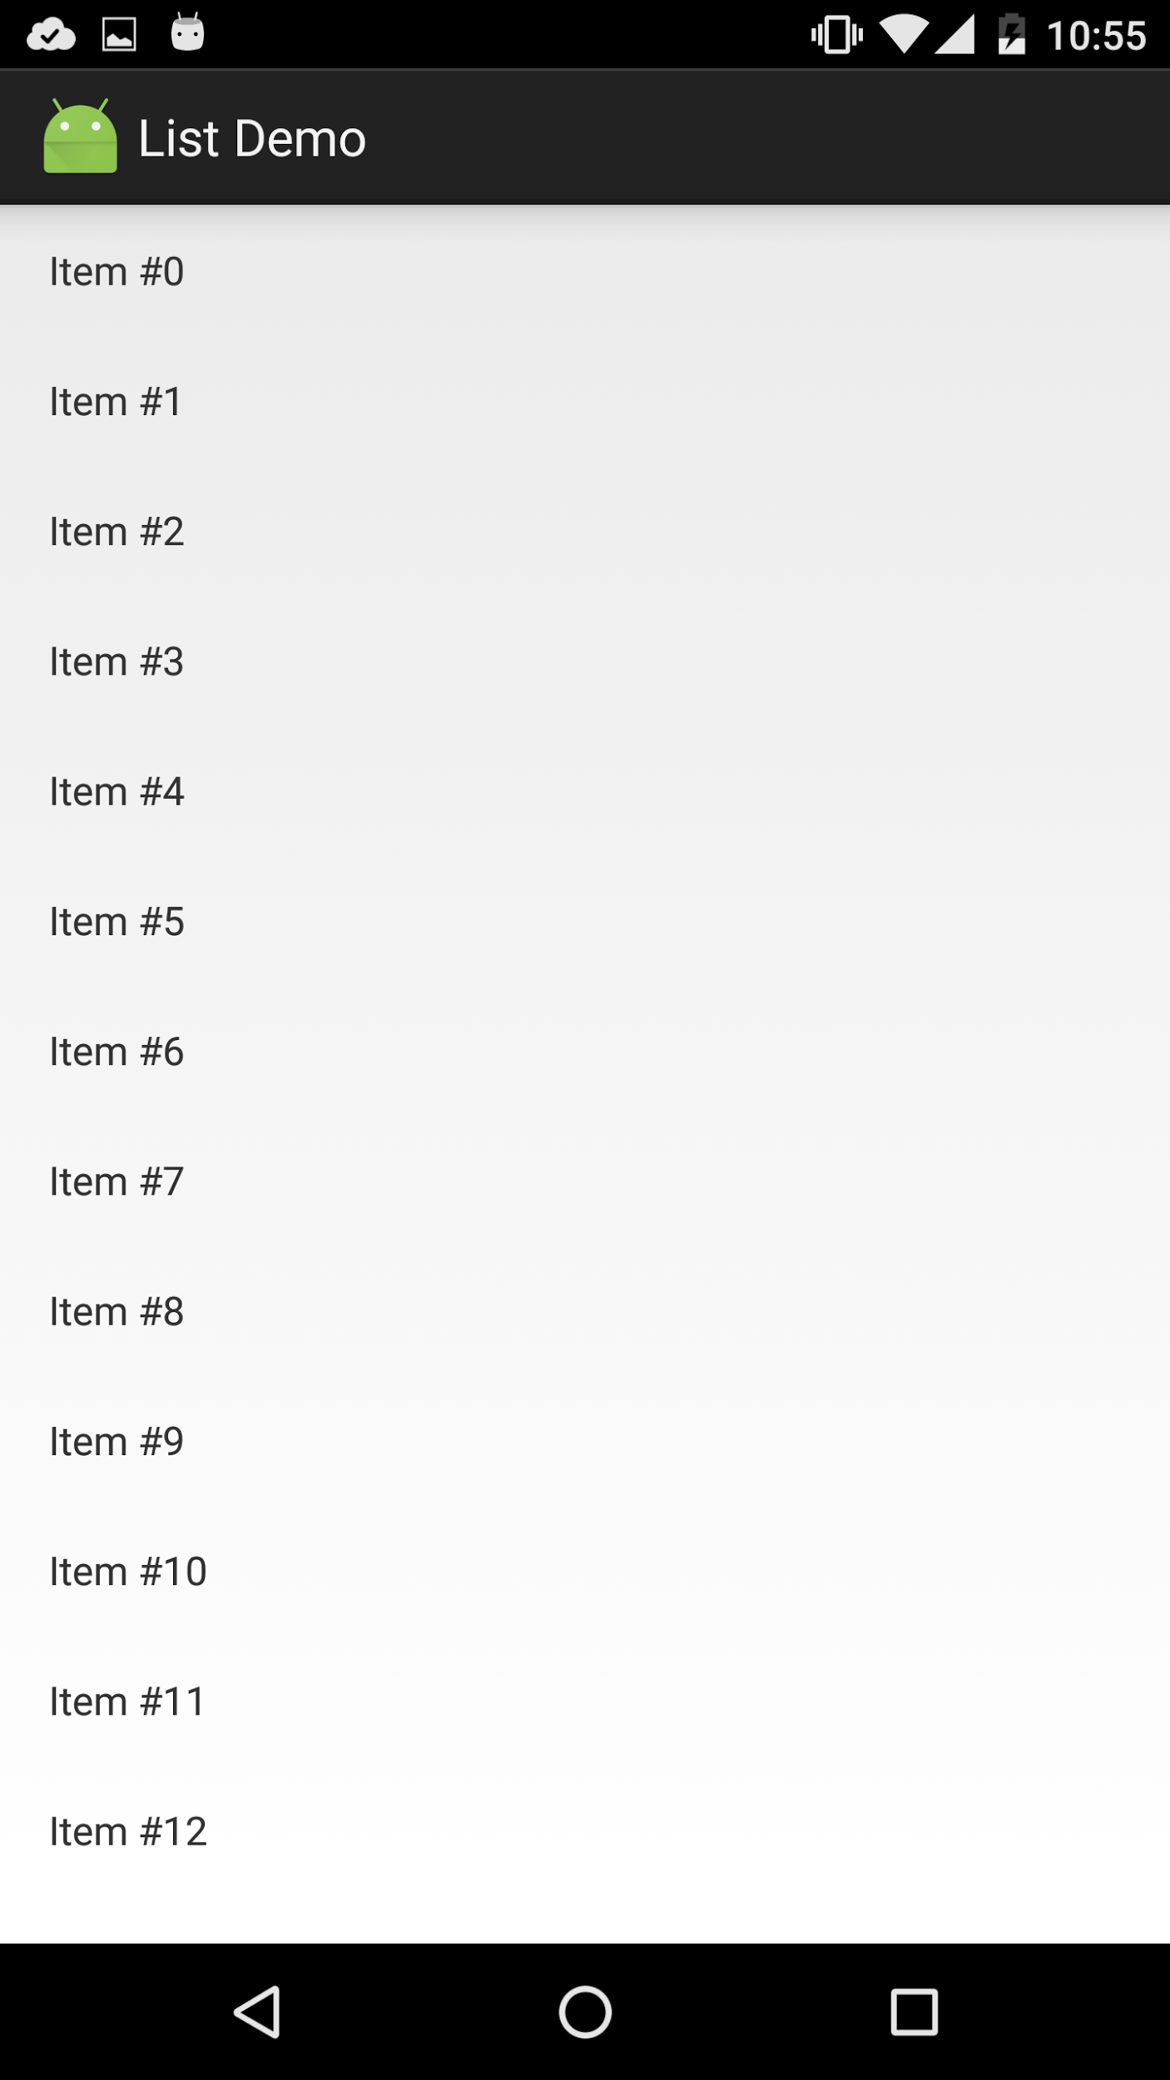
Adapter
Adapter
Данные

Slide 11
Adapter
public static abstract class Adapter<VH extends ViewHolder>
private class SimpleRecyclerAdapter extends
RecyclerView.Adapter<SimpleRecyclerAdapter.ViewHolder>

Slide 12

ViewHolder
Настройка одной ячейки
public void bindView(View view, int position) { TextView name = view.findViewById(R.id.name); TextView additional = view.findViewById(R.id.additional); ImageView image = view.findViewById(R.id.image); ... }

Slide 13
ViewHolder
class ViewHolder extends RecyclerView.ViewHolder { final TextView firstLine; final TextView secondLine; public ViewHolder(View itemView) { super(itemView); firstLine = (TextView)itemView.findViewById(R.id.fist_line); secondLine = (TextView)itemView.findViewById(R.id.second_line); } }

Slide 14
Convert View
Переиспользование View
@Override public ViewHolder onCreateViewHolder(
ViewGroup parent, int viewType) { return new ViewHolder(
li.inflate(R.layout.item_list, parent, false)); }

Slide 15
Convert View
@Override public void onBindViewHolder(ViewHolder holder, int position) { String str = items.get(position);
holder.firstLine.setText(str + " first"); holder.secondLine.setText(str + " second"); }

Slide 16
Обработка нажатий
public ViewHolder(View itemView) { super(itemView); // ... itemView.setOnClickListener(clickListener); }
@Override public void onClick(View v) { ViewHolder holder =
(ViewHolder)recyclerView.getChildViewHolder(v);
int position = recyclerView.getAdapterPositionFor(holder); }

Slide 17
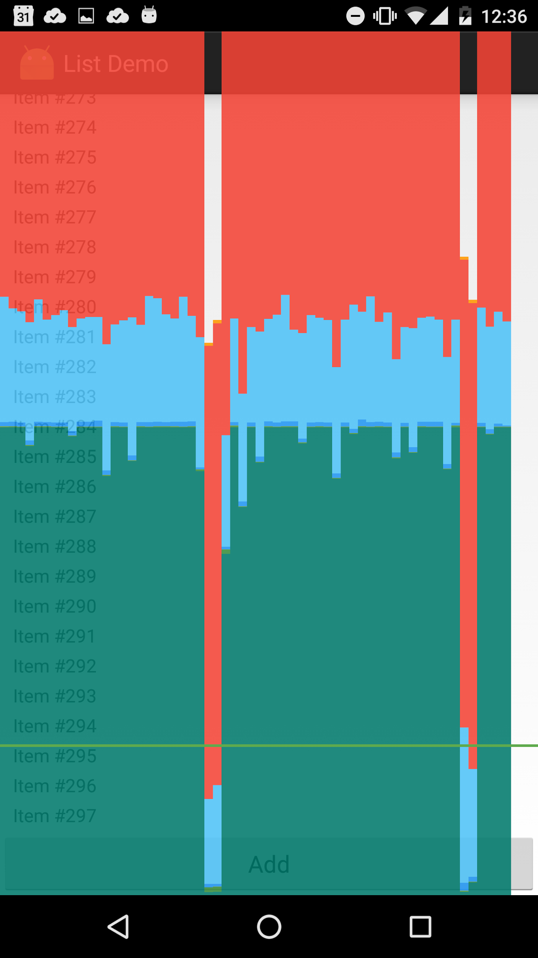
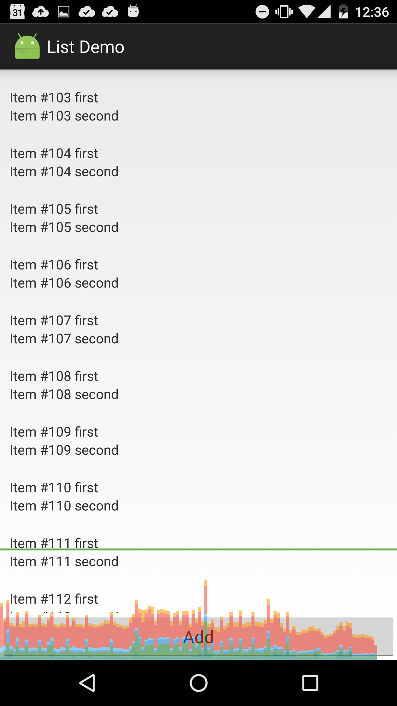
Сравнение

Slide 18
Собственные View

Slide 19
View
onDraw(Canvas c)
drawLine, drawRect, drawArc
Paint
onTouchEvent
Возвращем true, если обработали
MotionEvent
getAction
getX, getY

Slide 20
ViewGroup
onMeasure(int widthSpec, int heightSpec)
Верхние 2 бита - mode
EXACTLY, AT_MOST, UNSPECIFIED
Остальные - size
setMeasuredDimenstions
onLayout(left, top, right, bottom)
View#measure - измеряем “детей”
measureChild - LayoutParams -> MeasureSpec

Slide 21
Зачем это нужно?
Увеличение производительности
Упрощение вёрстки
Уменьшение вложенности
Не хватает возможностей стандартных компонент

Slide 22
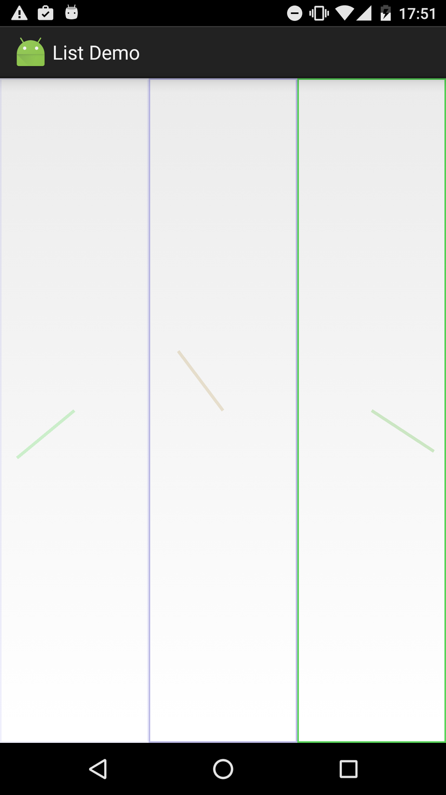
Пример

Slide 23
Пример. ViewGroup.
@Override protected void onMeasure(int widthMeasureSpec, int heightMeasureSpec) { int width = MeasureSpec.getSize(widthMeasureSpec); int height = MeasureSpec.getSize(heightMeasureSpec); int oneChildWidth = width / childCount; int oneChildWidthMeasureSpec = MeasureSpec.makeMeasureSpec(
oneChildWidth, MeasureSpec.EXACTLY); int oneChildHeightMeasureSpec = MeasureSpec.makeMeasureSpec(
height, MeasureSpec.EXACTLY); for (int i = 0; i < childCount; i++) { View child = getChildAt(i); child.measure(oneChildWidthMeasureSpec, oneChildHeightMeasureSpec); } setMeasuredDimension(width, height); }

Slide 24
Пример. ViewGroup.
@Override protected void onLayout(boolean changed, int l, int t, int r, int b) { int count = getChildCount(); int x = 0; for (int i = 0; i < count; i++) { View childAt = getChildAt(i); childAt.layout(x, 0,
x + childAt.getMeasuredWidth(),
childAt.getMeasuredHeight()); x += childAt.getMeasuredWidth(); } }

Slide 25
Пример. View.
public class AngleView extends View { private float angle; private final Paint paintAngle = new Paint(); private final Paint paintRect = new Paint();
public AngleView(Context context, AttributeSet attrs) { super(context, attrs); paintAngle.setColor(new Random().nextInt()); paintAngle.setStrokeWidth(10); paintRect.setColor(new Random().nextInt()); paintRect.setStrokeWidth(10); paintRect.setStyle(Paint.Style.STROKE); }

Slide 26
Пример. View.
@Override protected void onDraw(Canvas canvas) { super.onDraw(canvas); ... canvas.drawRect(0, 0, width, height, paintRect); canvas.drawLine(centerX, centerY,
(float)(centerX + minSize * Math.cos(angle)), (float)(centerY + minSize * Math.sin(angle)), paintAngle); angle += 0.1; invalidate(); }

Slide 27
Сенсоры

Slide 28
Сенсоры
sensorManager =
(SensorManager)context.getSystemService(Context.SENSOR_SERVICE);
sensor = sensorManager.getDefaultSensor(Sensor.TYPE_ORIENTATION);
sensorManager.registerListener(this, sensor,
SensorManager.SENSOR_DELAY_NORMAL);
sensorManager.unregisterListener(this);

Slide 29
Сенсоры
@Override public void onSensorChanged(SensorEvent event) { textView.setText("Value: " + event.values[0]); }

Slide 30
Вопросы?

